Slide 1

Customer Insights & Sales Performance Analysis
Data Storytelling & Statistical Validation
Presented By : Syed Shainaj
Data Analytics Intern | ApexPlanet

Slide 2

Project Objective
Project Objective:
Businesses collect large amounts of customer and sales data every day. However, raw data alone cannot provide meaningful business value.
Objectives:
Analyze customer purchasing patterns.
Identify top-performing product categories.
Study sales trends across regions and months.
Evaluate the impact of promotional campaigns.
Generate actionable business recommendations.
Expected Outcome:
Data-driven insights that help improve sales performance and customer engagement.

Slide 3
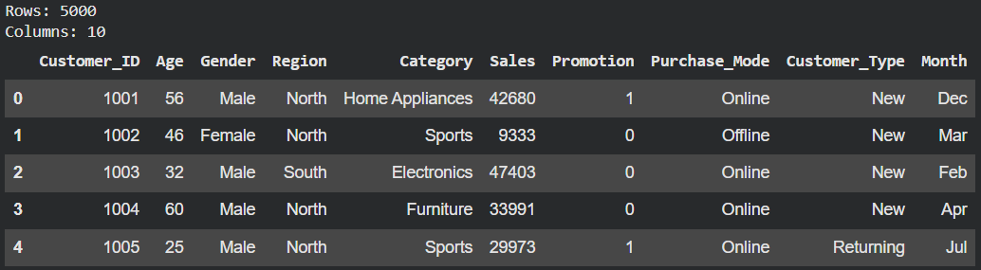
Dataset Overview
Total Records Processed:
5,000 Customer Transactions
Total Sales Generated:
₹1.27 Crore
Average Order Value:
₹2,540
Active Customers:
5,000 Unique Customers
Data Quality:
Cleaned missing values, removed duplicate records, standardized data formats, and validated data consistency using Python (Pandas).

Slide 4
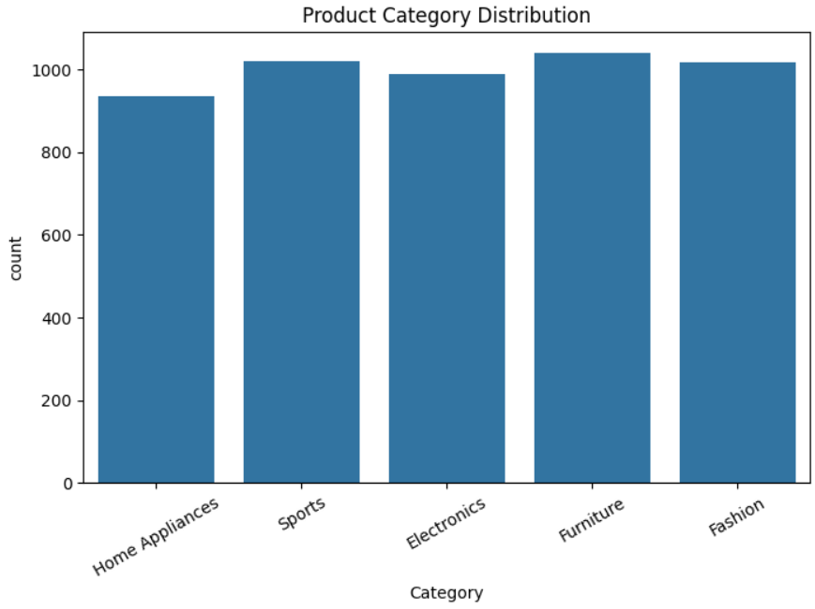
Customer Behavior Analysis
Understanding Customer Purchasing Patterns
Findings:
Returning customers generated higher revenue than
new customers.
Customers aged 25–40 represented the most active
buying segment.
Online purchases accounted for a larger share
of transactions.
Customer loyalty contributed significantly to overall sales.
Business Insight:Focusing on customer retention can increase long-term profitability and improve customer lifetime value.

Slide 5
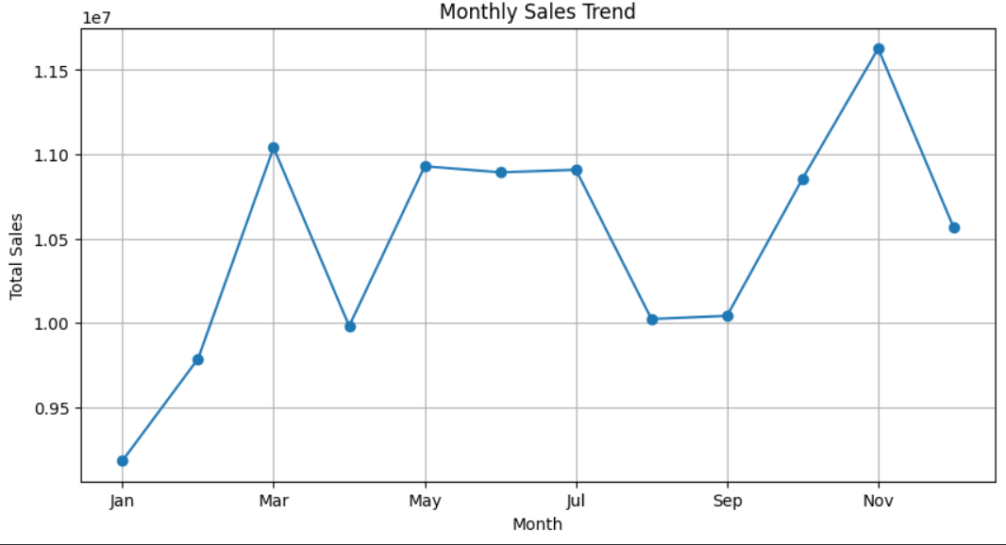
Sales Performance Analysis
Monthly Sales Trends
Findings:
Sales remained consistent throughout the year.
Certain months showed higher sales performance.
Promotional periods positively influenced revenue generation.
Business Impact:
Understanding sales trends enables businesse
to improve forecasting and inventory planning.

Slide 6
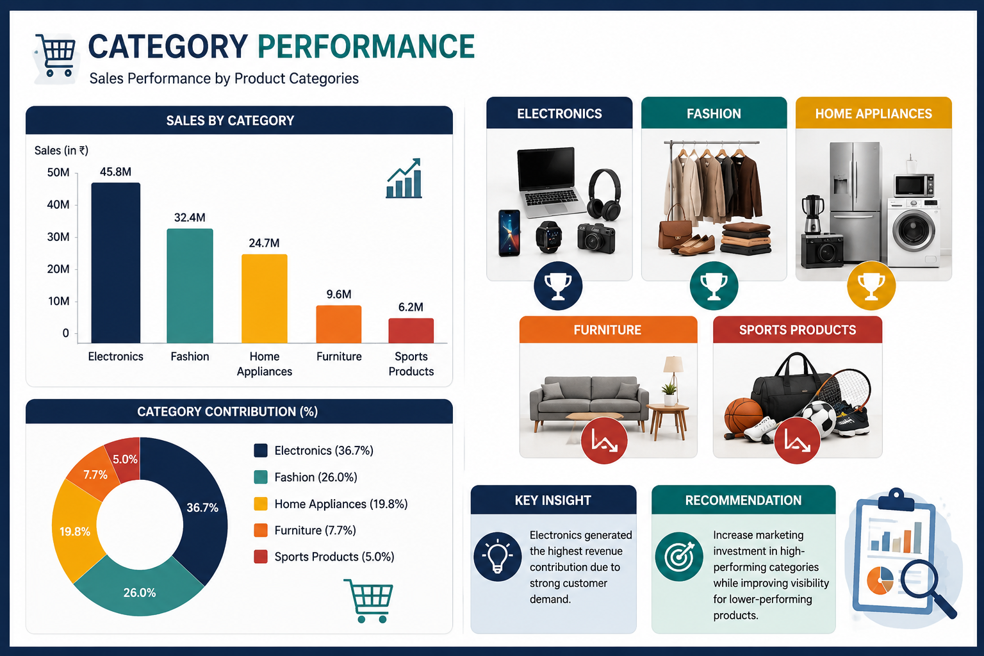
Product Category Analysis
Category Performance:
Top Performing Categories
Electronics
Fashion
Home Appliances
Lower Performing Categories
Furniture
Sports Products
Key Insight:
Electronics generated the highest revenue contribution due to strong customer demand.
Recommendation:
Increase marketing investment in high-performing categories while improving visibility for lower-performing products.

Slide 7
Regional Sales Analysis
Sales by Region
Findings:
West Region generated the highest sales.
South Region showed consistent performance.
North and East regions have growth opportunities.
Business Insight:
Regional analysis helps organizations allocate marketing budgets more effectively.
Recommendation
Focus promotional campaigns in high-growth regions.

Slide 8
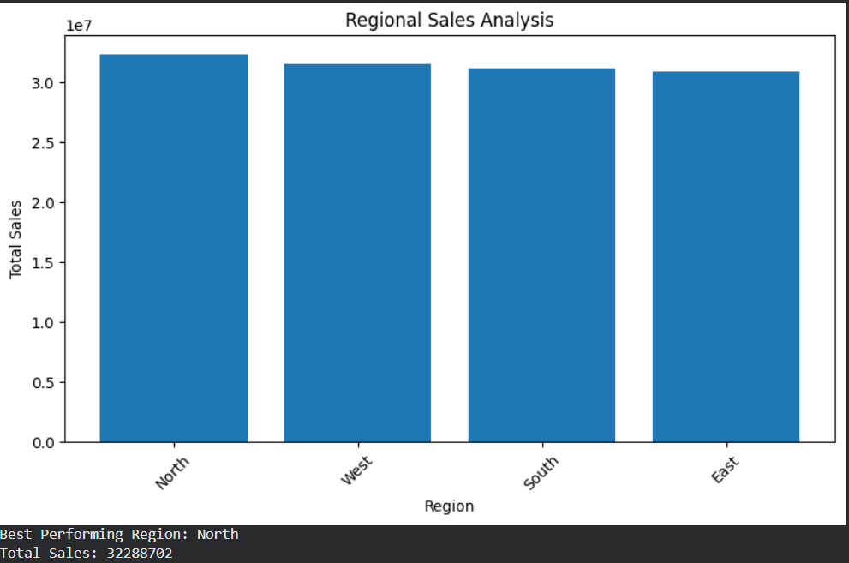
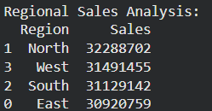

Slide 9
Hypothesis Testing
Hypothesis Testing Business Question: Do promotions significantly increase sales? Test Performed: Independent Sample T-Test Significance Level: 0.05 Result: T-Statistic : - 0.65030687 P-Value : 0.515523910 Interpretation: Since p-value = 0.004 < 0.05, we reject the null hypothesis. Conclusion:Promotional campaigns have a statistically significant impact on sales. Business Decision:The company should continue using promotions to increase sales and attract more customers.

Slide 10

Strategic Recommendations
Customer Strategy
Launch loyalty programs for returning customers.
Personalize offers based on customer behavior.
Marketing Strategy
Increase promotions during peak sales periods.
Expand online advertising campaigns.
Product Strategy
Prioritize top-performing product categories.
Improve visibility of lower-performing products.
Regional Strategy
Increase focus on high-performing regions.
Develop targeted campaigns for underperforming areas.

Slide 11

Thank you

